Slide 1


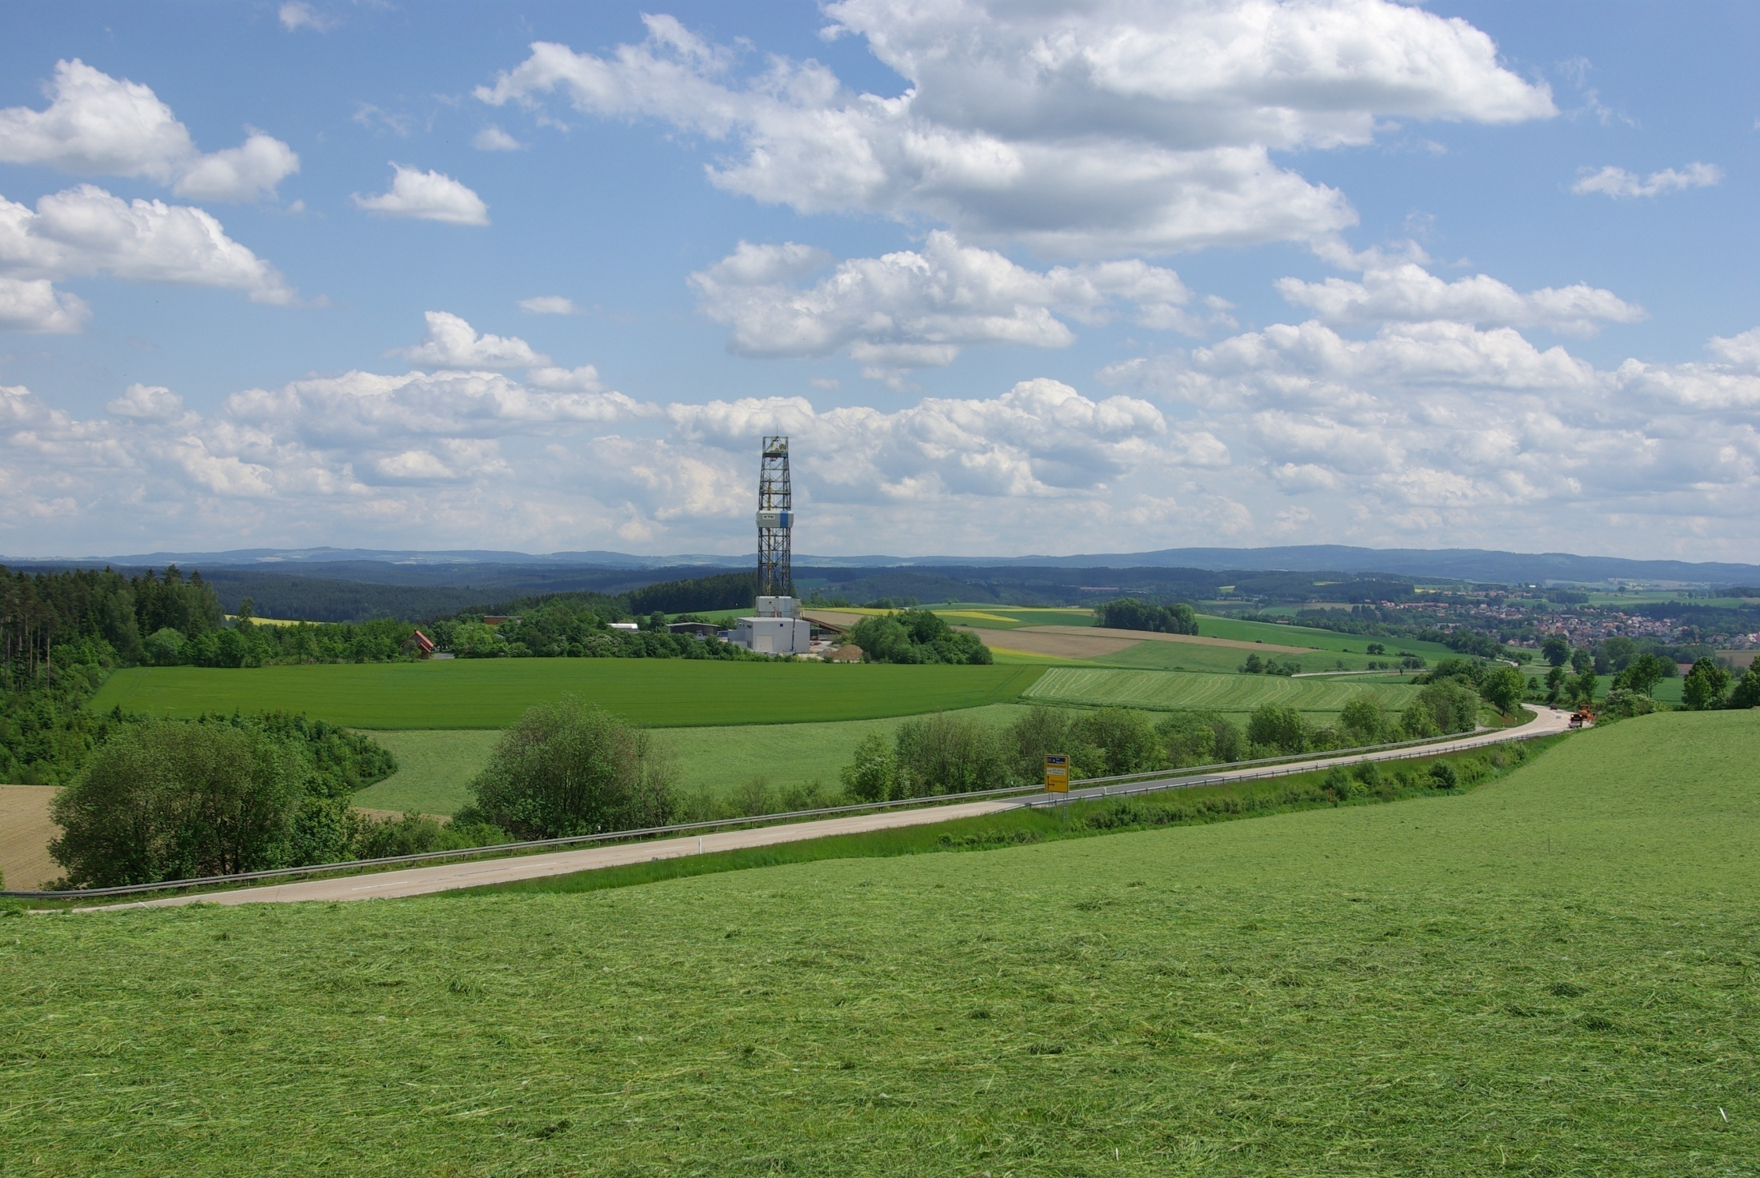
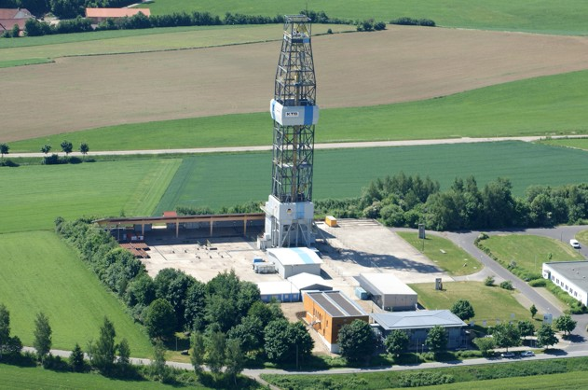



The GEO-Zentrum an der KTB
–
History and usage for outreach and education
Dr. Frank Holzförster

Slide 2
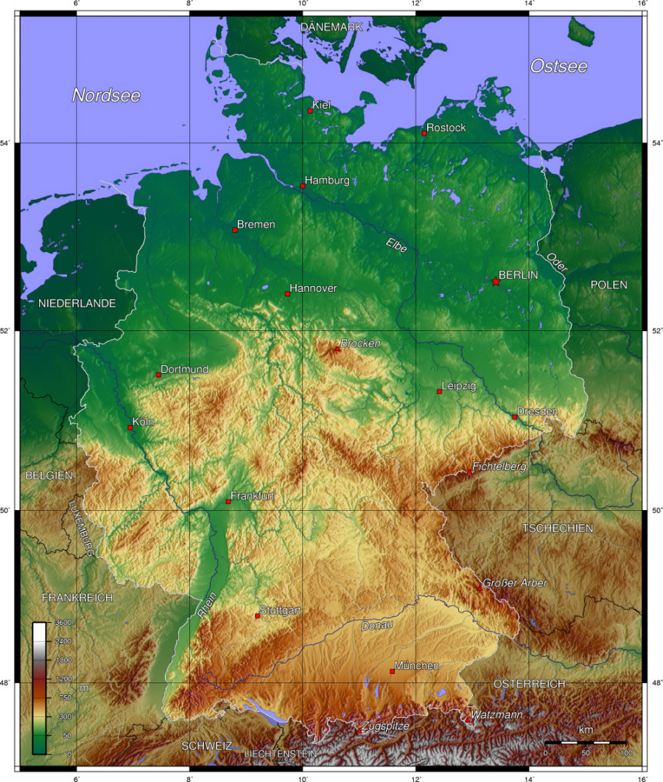
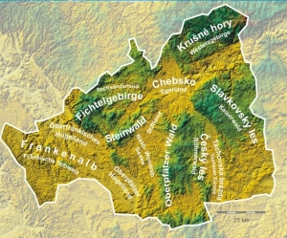


Location: on the Franconian Lineament
1
190 km north of Munich
170 km west of Prague
in the heart of the
Czech-Bavarian Geopark
+
X
Frank Holzförster - ICDP 15.-17.05.2018
Notes:
„So etwas habe ich noch nie erlebt“, sagte er. Dass sich solch ein „Riesenbrocken“ aus der Wand gelöst habe, sei „völlig unerwartet“ geschehen. „Das Haus stand dort seit 1910, da war noch nie etwas passiert.“

Slide 3
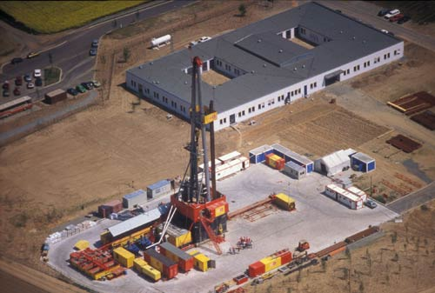
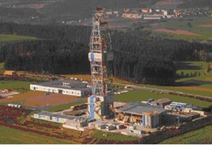
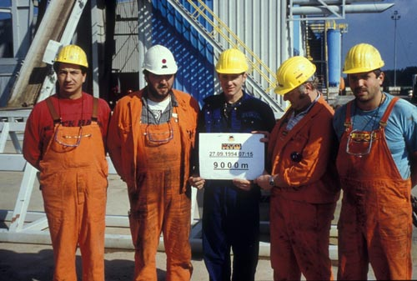
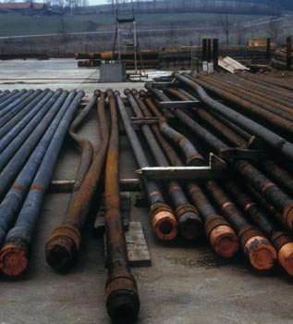
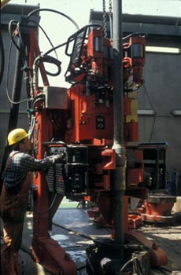
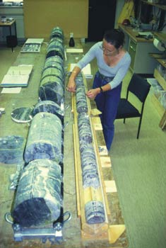
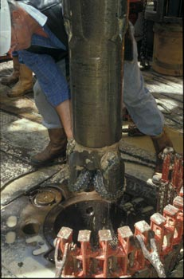
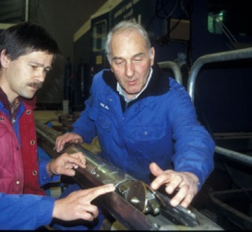
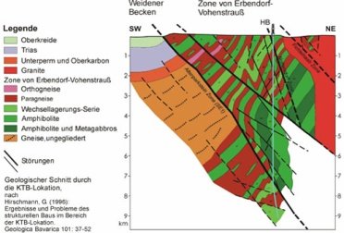
Background
2
Continental Deep Drilling Program of the Federal Republic of Germany (KTB)
Fundamental research project (1987 - 1994) with two 4.000 m and 9.101 m deep
drillholes exploring the continental crust
Frank Holzförster - ICDP 15.-17.05.2018

Slide 4
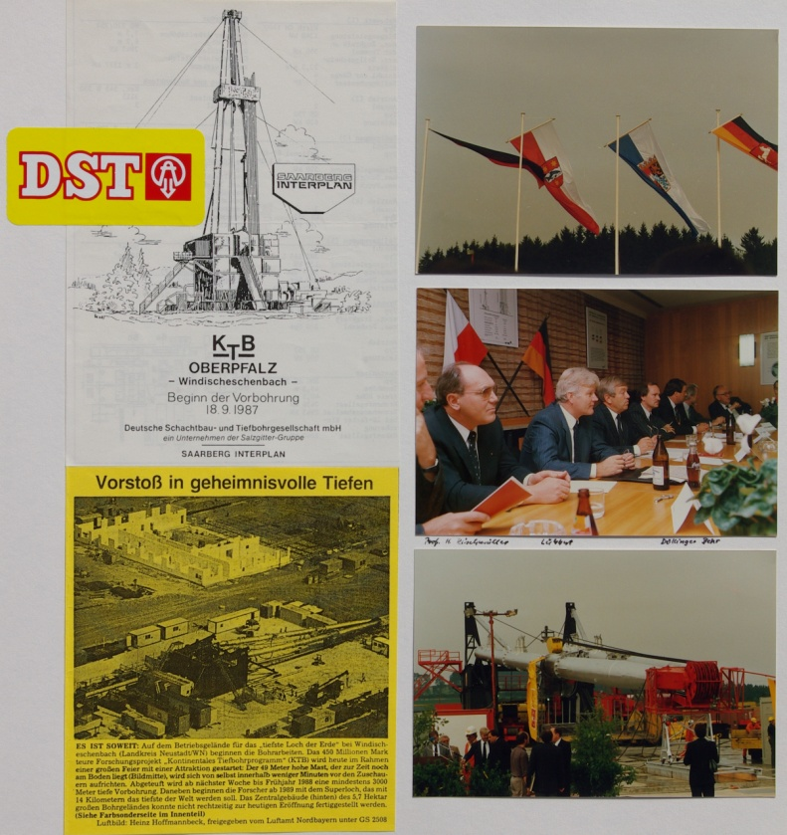
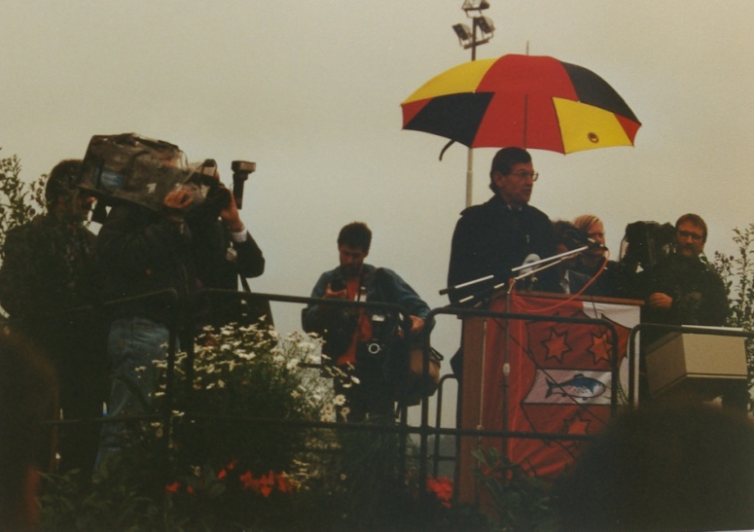
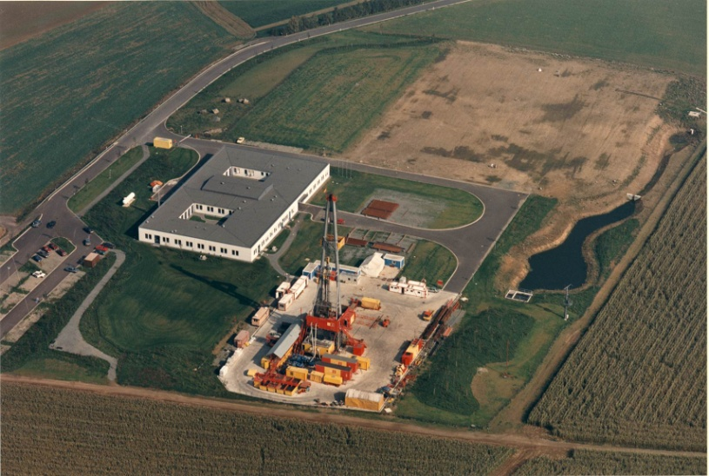
Development
3
1987: Start of active drilling phase for
pilot hole KTB-VB
1989: Completion of KTB-VB at 4.000,1 m
1990: Start of active drilling phase for
main hole KTB-HB
Frank Holzförster - ICDP 15.-17.05.2018

Slide 5
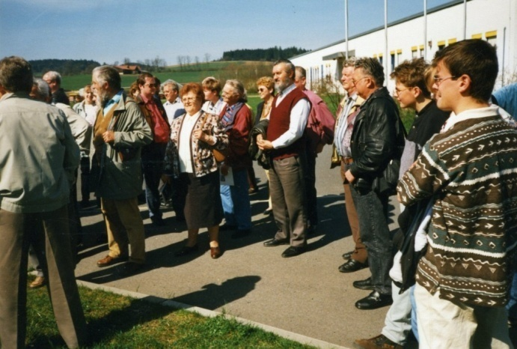
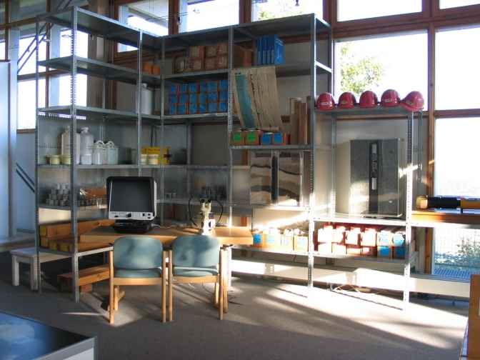
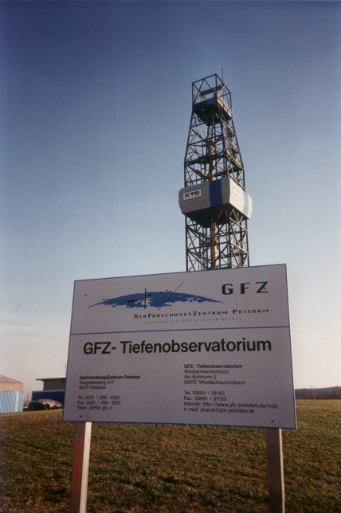
Development
4
1990: Public interest results in tours to the
drilling site (guided by the academic
staff of the field laboratory)
1992: Installation of Information Centre KTB
with own staff (financed by federal
german and bavarian state governments)
1994: Completion of KTB-HB at 9.101 m
1996: Completion of initial research
program
1994-98, ongoing: Long term measuring
programs develop towards Deep
Crustal Laboratory of GFZ Potsdam
Frank Holzförster - ICDP 15.-17.05.2018

Slide 6
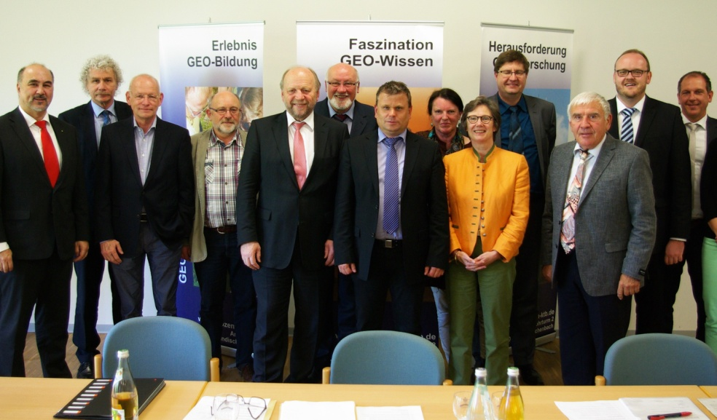




Development
5
1998: Registration of the legal society GEO-Zentrum an der KTB e.V.
to secure the information centre now named GEO-Zentrum an der KTB
(financed by local administration and private people; its purpose is to establish the
GEO-Zentrum an der KTB as an Geoscience Outreach Centre and to strengthen
the geosciences in the German educational system)
2004: Reorganisation of the financial basis of the institution, achieved by
communal, commercial and industrial founders of the Foundation GEO-
Zentrum an der KTB (sole purpose is supporting the GEO-Zentrum an der
KTB; founding members are district Neustadt a.d. Waldnaab, district Tirschenreuth,
Vereinigte Sparkassen Eschenbach Neustadt Vohenstrauß, KCA DEUTAG Drilling
GmbH, town of Windischeschenbach)
Frank Holzförster - ICDP 15.-17.05.2018

Slide 7
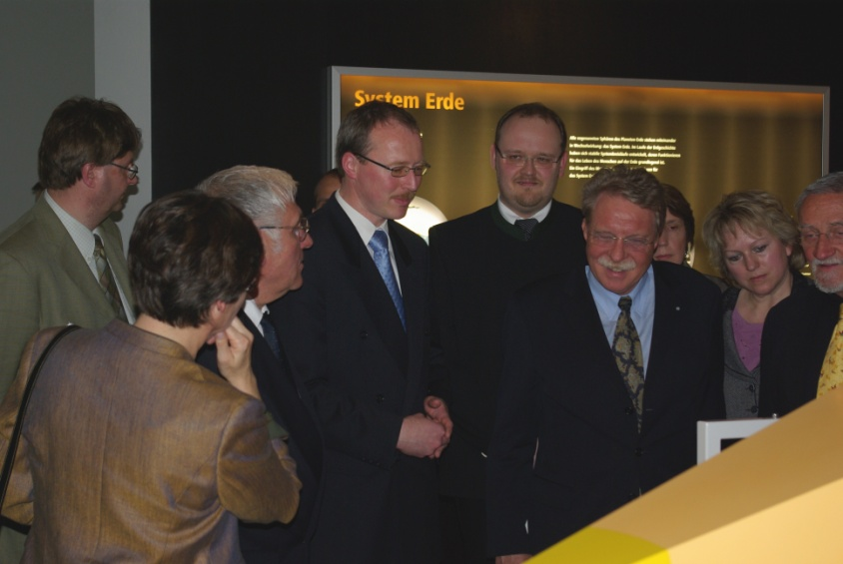
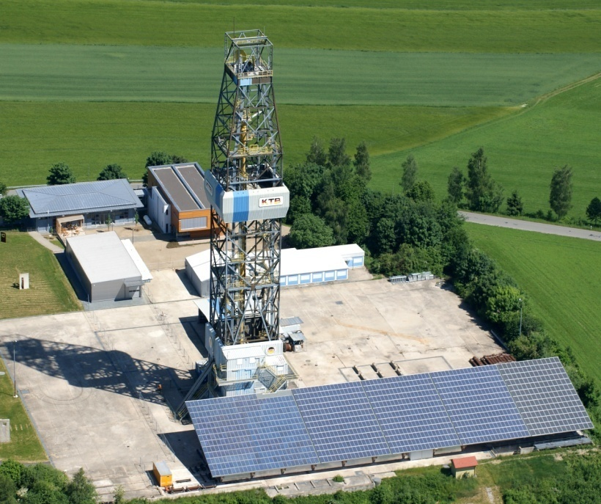
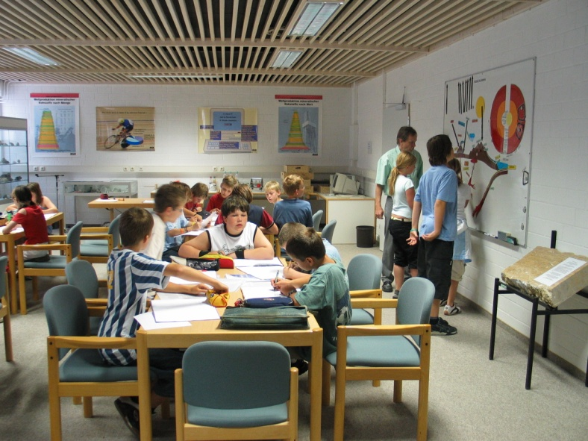
Development
6
2004: Installation of Out-of-school Geoscience Laboratory ‘GEO-Lab ‘
(themes: rocks, soil, plate tectonics)
2006-08: Building Activities (core shed, two exhibition halls, enlargement of the
GEO-Lab)
2008: Opening of permanent exhibition ‘System Earth‘
Frank Holzförster - ICDP 15.-17.05.2018

Slide 8
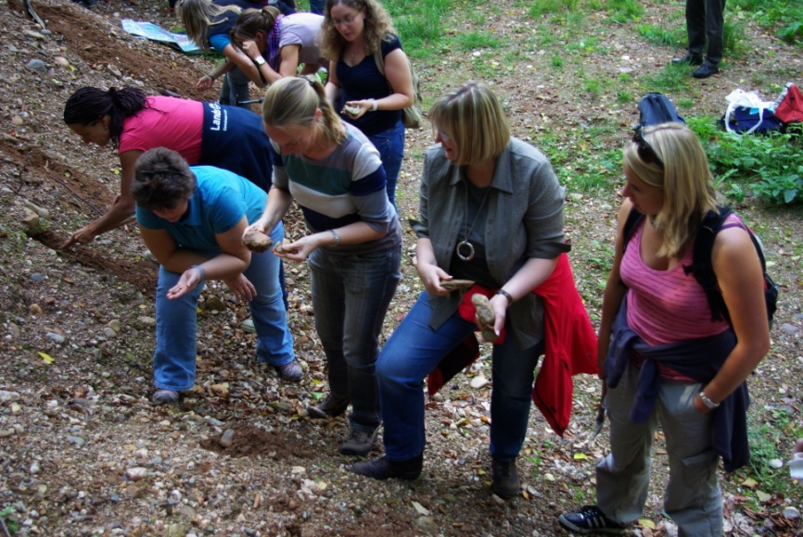
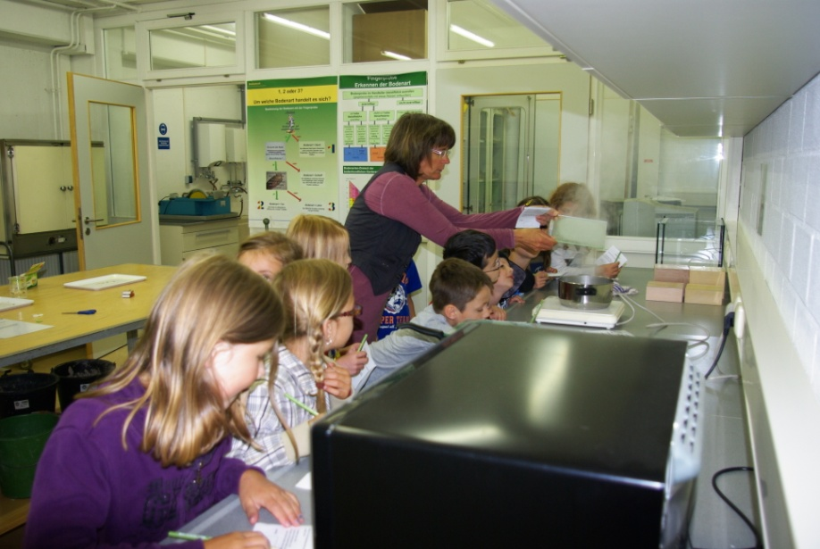
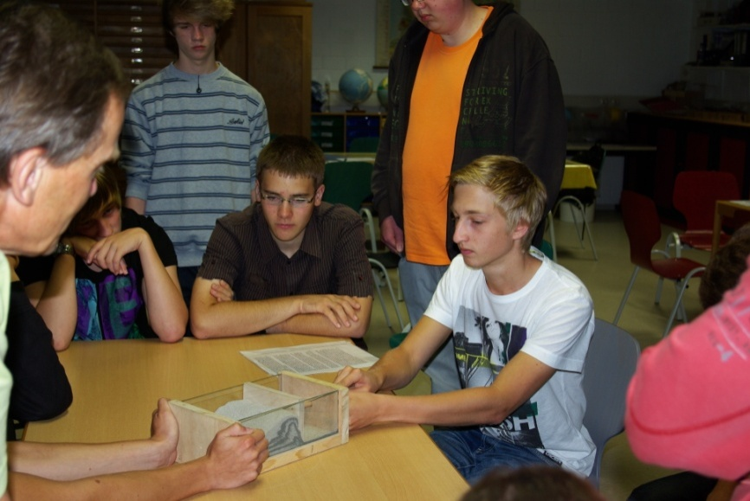
Development
7
2008-10: Widening of educational program
(themes: tectonics, energy, natural ressources, volcanism, earthquakes, program
adaptions for primary and pre-primary schools)
2009: Further Education Program for Geography teachers, more than 900
participants since then
Frank Holzförster - ICDP 15.-17.05.2018

Slide 9
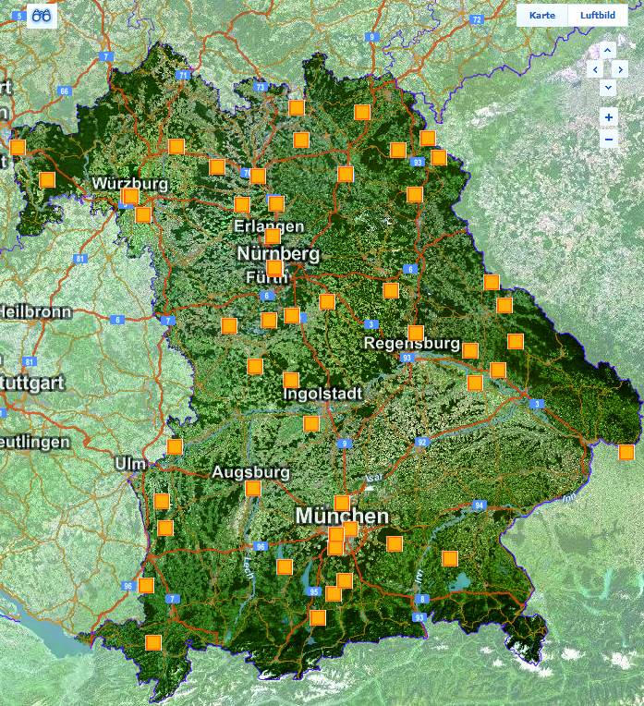
Development
8
2011: Umweltstation, with the focus
on Geosciences (School of Education
for Sustainable Development) approved
by Bavarian State government
2012: Permanent exhibition
‘Minerals of the Oberpfalz-Region‘
2013: Partner Education Program with
school administration and schools in
Czech Republic, Plzen district (high school
level)
2013: Widening of educational program (for job-specific education)
2014: Partner Education Program with University Erlangen-Nürnberg
(development of MSc-Studies in Didactics in Geological Sciences, for
Geography teachers)
Frank Holzförster - ICDP 15.-17.05.2018

Slide 10
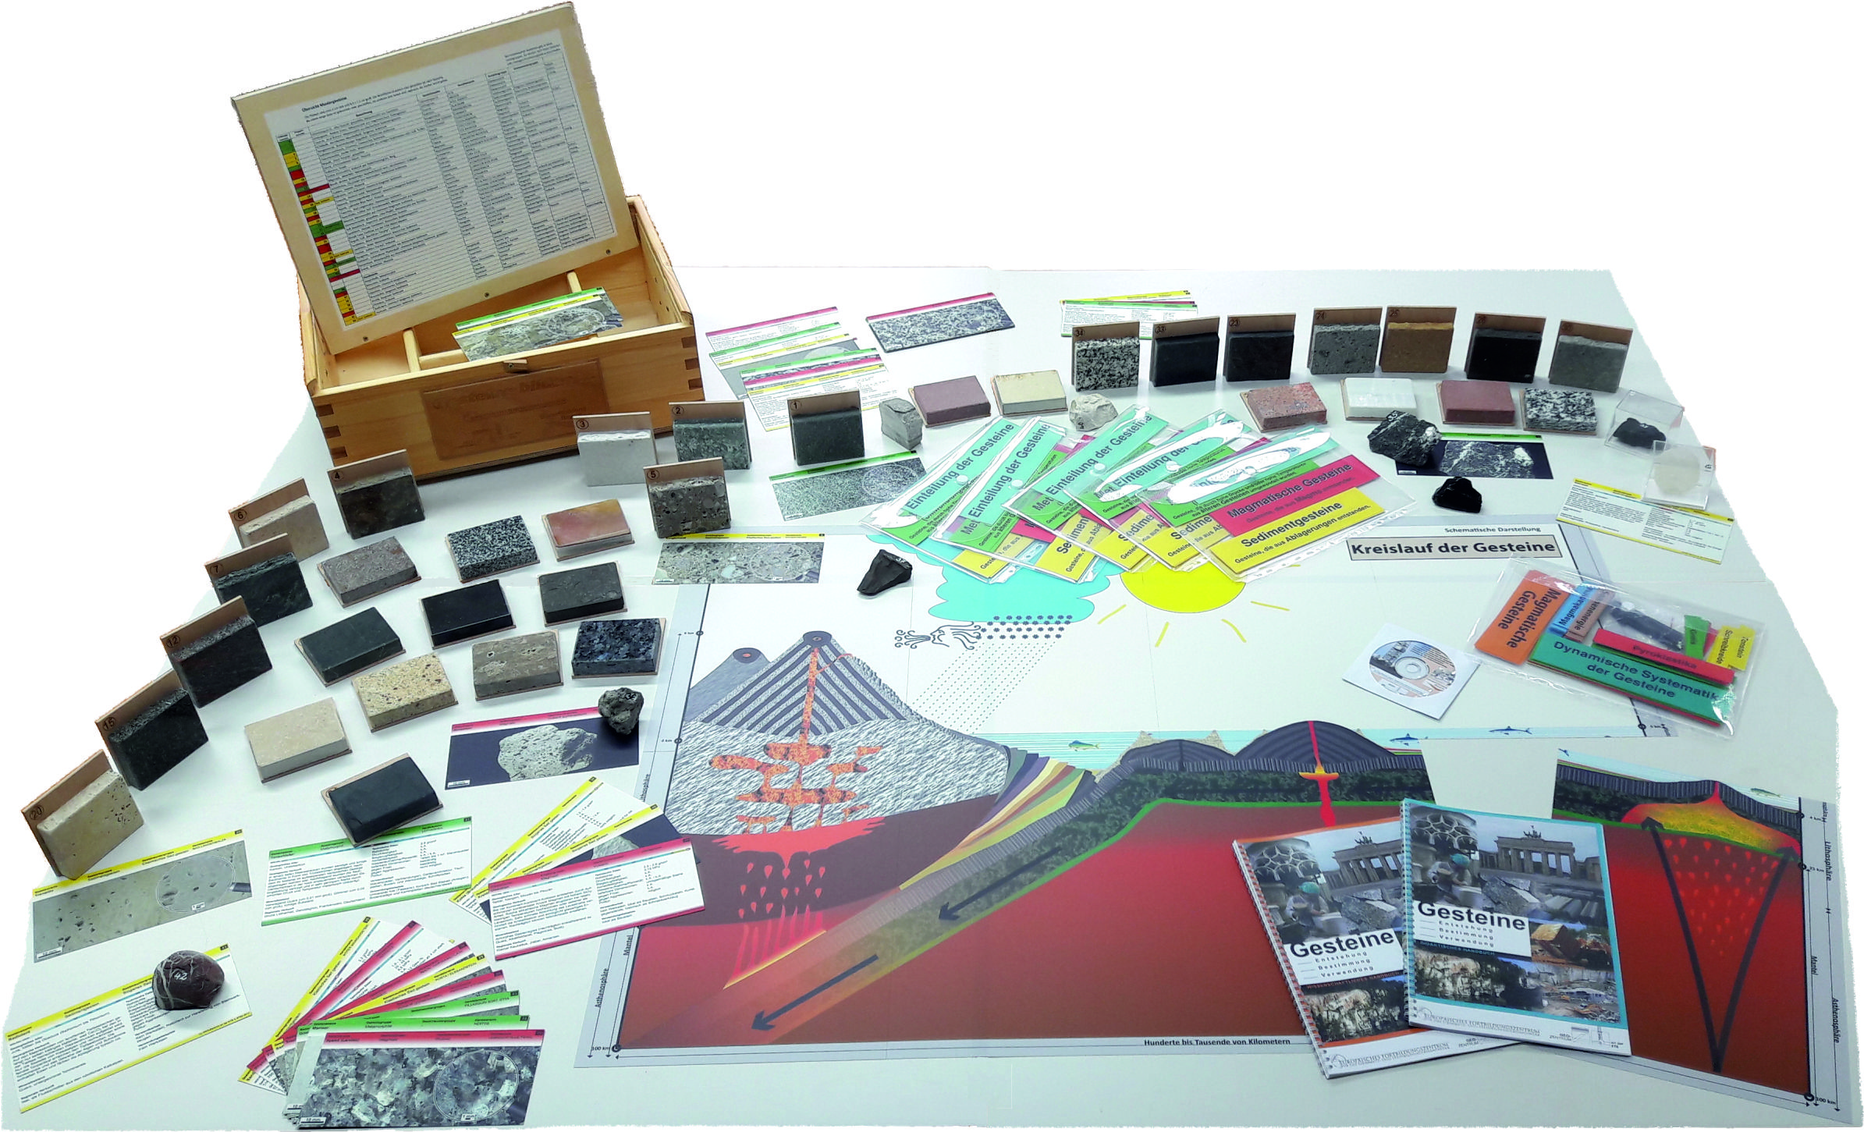
Development
9
2015: Partner Education Program with University of Pedagocics in Agriculture
and Environmental Education Vienna, Austria,
2015: Partner Education Program with Goethe Institut Tbilissi, Georgia (tri-
national school partners in the Caucasus region for environmental eduction
transported in german lessons)
2016: Kita to go – A program visiting pre-primary schools for early education
in geology
2017: Launch of „The Rock Box“
for teaching on rock identifi-
cation and on the rock-cycle
Frank Holzförster - ICDP 15.-17.05.2018

Slide 11


Acknowledgements and awards
10
2004: Assignment of teaching load (2 hours) by the Bavarian State Ministry of
Education, renewed in 2005
2006: Selected Landmark in the
Land of Ideas 2006 (national innovations award)
2006: Assignment of teaching load (4 hours)
by the Bavarian State Ministry of Education,
renewed in 2006 and 2007
2007: E.On Bayern Umweltpreis 2007
(environmental education award)
2008: Umweltbildung.Bayern (quality certificate for
excellent education for sustainable development),
since then bi-annually renewed
Frank Holzförster - ICDP 15.-17.05.2018

Slide 12
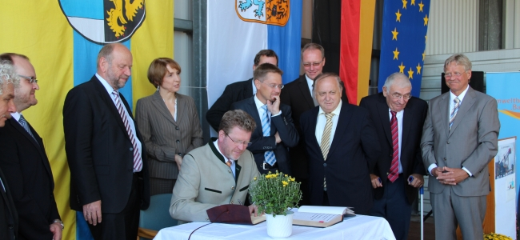
Acknowledgements and awards
11
2008: Assignment of teaching load (10 hours) by the Bavarian State Ministry of
Education, annual renewals
2010: Umweltstation approved by Bavarian Committee of Sustainability
2010: Decade Project 2010/11 (awarded by the United Nations Decade of Education
and Sustainable Development)
2017: Assignment of teaching load (12 hours) by the Bavarian State Ministry of
Education
Frank Holzförster - ICDP 15.-17.05.2018

Slide 13

















































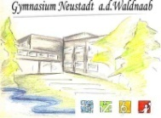




Network of partners
12
Public administration
Out-of-school learning
Tourism
Museum
Industry
Science
Education for sustainable development
Media
School
Teacher further eduction
Frank Holzförster - ICDP 15.-17.05.2018
Notes:
Gerade das Netzwerk ist zu einem wirksamen Instrument geworden und hat eine erstaunliche Tragweite errungen. Die unmittelbare Vernetzung mit vielen Partnern geht zu den Universitäten , mit denen das GEO-Zentrum unmittelbar zusammenarbeitet. Zur Umweltbildungsszene in Bayern gehört wir als eine der großen Umweltstationen direkt dazu und sind dort selbstverständlich auch intern über Verbände und Qualitätssiegel (Umweltbildung.Bayern) vernetzt. Quer durch die Umweltbildung verläuft die Bindung in die Schulen, denen wir Unterrichtsmaterialien und spezielle Programmangebote zur Verfügung stellen; umgekehrt sind die Schulen lose Partner, die sich beratend in die Gestaltung unseres Programms einbringen. Im Bereich der Lehrerbildung sind wir mit Programmpartnern, Lehrerverbänden und der Schulpolitik verbunden. Eine enge Bindung existiert auch zur kommunalen Verwaltung, für welche die Umweltstation Dienstleister und Themenmultiplikator ist und die sich andererseits finanziell und ideell beteiligen. Die Industrie sieht uns als Sprachrohr und Stimmungsbarometer in der Region, unterstützt uns finanziell, durch Materialspenden und durch den Zugang zu Unterlagen und Steinbrüchen oder führt uns Dritte zu. Kooperationen mit anderen Museen und anderen außerschulischen Lernorten stellt einen befruchtenden Erfahrungsaustausch dar. Für den Tourismus in der Region sind wir ein wichtiger Partner, der viele Menschen in die Region holt und damit auch bei Weichenstellungen und Entscheidungen gehört wird. Der offene Umgang mit den Vertretern der Presse ist für uns selbstverständlich, umgekehrt tritt die Presse bei unseren Bildungsprojekten auch gern als Medienpartner auf.

Slide 14
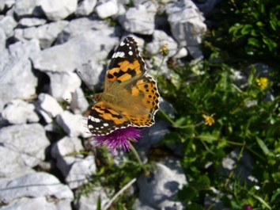
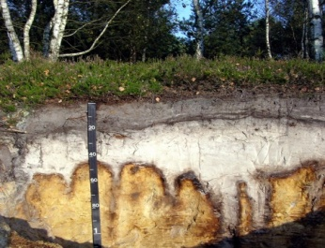
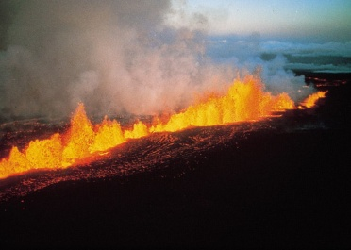
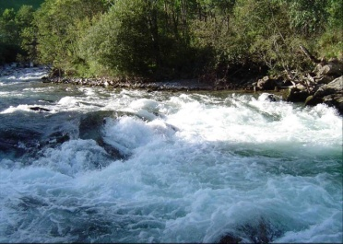
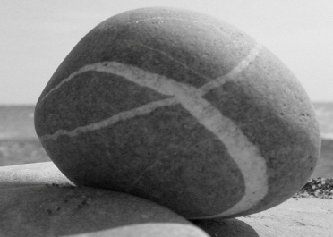

Aims
13
People shall understand the various processes that characterise the complex System Earth. Using this knowledge they shall act responsible within our common living environment.
Realizing the connectivity of the interior and exterior dynamics of the planet.
Understanding the interaction of System Earth (litho-, pedo-, hydro-, atmosphere).
Informing about the importance of fundamental research.
Stimulating interest in natural sciences and engineering.
Frank Holzförster - ICDP 15.-17.05.2018

Slide 15
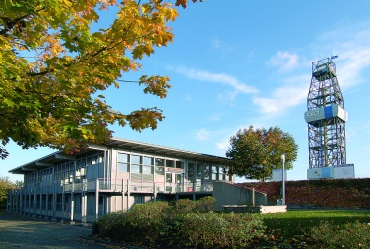
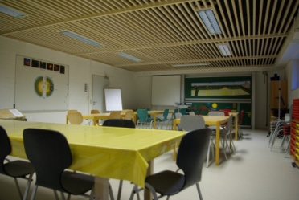
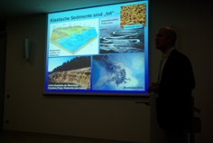
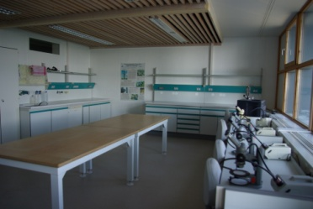
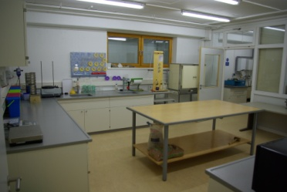
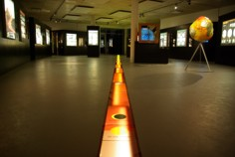
Personnel & premises
14
Personnel:
1 Geologist
1 Biologist
2 Geography teachers
1 Environmental educator
8 Tourist guides
2 Technical staff
2 Cleaning staff
2 seminar rooms
2 lab-rooms
3 exhibition halls
drilling rig with visitors platform
core shed
chamber of seismometer
lecture hall
caféteria
museum shop
Premises:
11.000 m² land
1.600 m² indoor space, comprising:
Frank Holzförster - ICDP 15.-17.05.2018

Slide 16

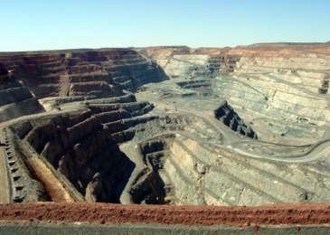
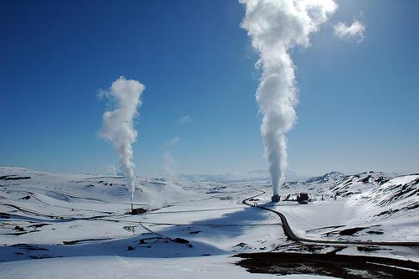
Learning opportunities
15
Families, adults, public groups
Interested people shall explore the slowly acting, complex processes of change
within the solid Earth and shall realize the interaction of the geological processes
with life and society.
Activities for everybody
Guided tours
Geological field trips
Public talks
Mineral and fossil fairs
Conferences and workshops
Programmes for children
Concerts
Focus themes, e.g. soil
Frank Holzförster - ICDP 15.-17.05.2018

Slide 17
Learning opportunities
16
Teachers and teaching assistants
Multiplicators learn to teach research as a matter of various linked school
subjects, which only together can successfully address the major issues
of the future. Understanding the System Earth as the human habitat
serves as example for interdisciplinary research that involves physics,
chemistry, geology, drilling technique, geodesy, biology, informatics etc.
Approved further training for multiplicators
Soil – fundament of life
Geology – valuing Earth
Landscape evolution
Didactics in teaching Geology
Volcanism
Geodynamics – the dynamic system Earth
Akademie für Naturschutz
und Landschaftspflege
Frank Holzförster - ICDP 15.-17.05.2018

Slide 18
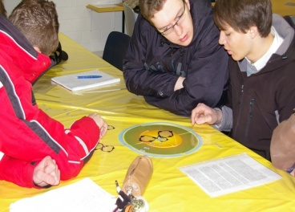
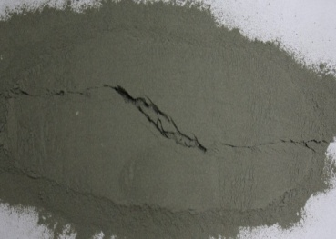
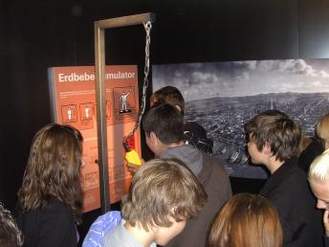
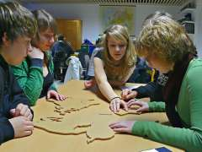
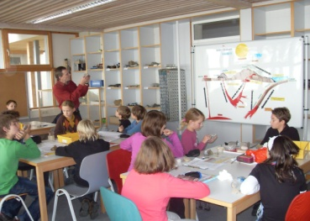
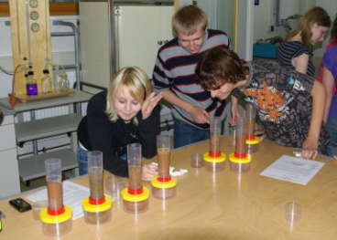
Learning opportunities
17
School children (from 11 yrs old)
In class they engage with particular aspects of the System Earth. Learning
modules of 3 hours duration offer an understanding of the basics and an
insight to actual questions in geoscientific research.
5th year in school, on highest intellectual level
Learning modules
Rocks – the base of the world (5,7 - 5,6,9 - 5)
Formation, analysis and vulnerability of soils (5,7 - 7,9 - 5)
Plate tectonics (5 - 5,7,8,9 - 5,10,11)
Tectonics (orogeny, rifting, faulting) (5 - 5,7,8,9 - 10,11)
Energy ressources (9 - 6,7,9 - 7,11)
Natural ressources (9 - 6,7,9 - 7,8,11)
Volcanism (5,7,8,9 - 7,10,11)
Earthquakes (5,7,8,9 - 7,10,11)
HS - RS - Gym
Frank Holzförster - ICDP 15.-17.05.2018

Slide 19
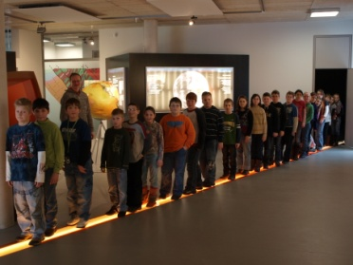




Learning opportunities
18
School children (from 11 years old)
In class they engage with particular aspects of the System Earth. Learning
modules of 3 hours duration offer an understanding of the basics and an
insight to actual questions in geoscientific research.
Guided tours + field excursions
Age-appropriate visits of the exhibition „System Earth“
Exploring the drilling-rig
Field excursions exploring geotopes near the KTB-site
Frank Holzförster - ICDP 15.-17.05.2018

Slide 20






Learning opportunities
19
School children (from 6 – 10 years old)
In small research teams they investigate the System Earth. The learning
modules of 2 hours duration stimulate the independent examination of
natural processes.
Learning modules
Researching rocks (3,4)
Exploring the soil (3,4)
Seasons, climate, weather (3,4)
Energy – a peculiar „matter“ (3,4)
4th year in school
Frank Holzförster - ICDP 15.-17.05.2018

Slide 21
Learning opportunities
19
Children (younger than 6 years old)
Playing with rocks and simple learning models and listening to fancy stories
young children experience interesting aspects of nature. The learning modules
of 1,5 hours duration stimulate the childrens interest in how nature works.
Learning modules
The story of rocks
Living in healthy ground
What clouds tell
Hedge, meadow, lawn - life based on soil
Frank Holzförster - ICDP 15.-17.05.2018

Slide 22
Learning opportunities
20
Teachers in education
As future multiplicators they are encouraged to show that research means
scientific work crossing the boundaries of school subjects in order to find
answers on demanding questions like the access to ressources and energy.
Researching System Earth forms an example for interdisciplinary research
involving geophysics, geochemistry, geology, drilling technology, geobiology,
geoinformatics, geodesy etc.
MSc. studies Didactics in Geology
Module Models in Geology
Frank Holzförster - ICDP 15.-17.05.2018

Slide 23
Learning opportunities
21
Students
At an authentic site of fundamental research they shall recognize research
as fruitful interaction of numerous disciplines and will experience aspects
and methods of science communication into the public.
Field trip target for:
RWTH Aachen
TU Berlin
TU Clausthal
TU Darmstadt
TU Dresden
University Erlangen-Nürnberg
TU Bergakademie Freiberg
University of Freiburg
University Göttingen
University of Graz, Austria
University of Greifswald
University of Halle-Wittenberg
University of Heidelberg
Hochschule Hof
Karlsruhe Institute of Technology
University of Leoben, Austria
University of Mainz
University of Maryland, U.S.A.
Open University Milton Keynes, GB
TU Munich
University of Oldenburg
University of Plzen, Czech Republic
Prague University, Czech Republic
University of Regensburg
University of Vienna, Austria
University of Wageningen, Netherlands
Frank Holzförster - ICDP 15.-17.05.2018

Slide 24
Structure of participants
22
Frank Holzförster - ICDP 06.-11.11.2017

Slide 25



Quality management
23
Evaluation:
Institute for the Didactics of Geography
Advisory board:
Academy for nature protection and landscape management (education)
Baverian Academy for further education of teachers (education)
Bavarian State Ministry of Environmental Affairs and Consumer Protection (administration)
Bavarian State Ministry for Education, Culture and Science (administration)
Federal Institute for Geosciences and Natural Ressources (science)
German Petroleum Museum (education)
Geological Survey of Bavaria (administration)
Helmholtz Centre Potsdam GFZ German Research Center for Geosciences (science)
Institute for Educational Quality and Research in Education (science)
TU Bergakademie Freiberg, Institute for Lagerstättenlehre (science)
University of Bayreuth, Bavarian Geosience Institute (science)
University of Erlangen-Nürnberg, Geocenter Northern Bavaria (science)
Frank Holzförster - ICDP 15.-17.05.2018

Slide 26


Logistics
24
Lab days 4 days per week
Capacity 2 groups of 30 participants each
Languages German, English, Czech
Bookings www.geozentrum-ktb.de, +49 9681 400430
Costs ½ day: 5,50 €, 1 day: 7,50 €
Accessibility motorway, railway
Accommodation 1 youth hostels and 1 church retreat house nearby
Frank Holzförster - ICDP 15.-17.05.2018

Slide 27








25
Geosciences –
view, understand, apply!
GEO-Zentrum an der KTB
Windischeschenbach, Germany
Frank Holzförster - ICDP 15.-17.05.2018

